Slide 1

Clinical Trials - Enterprise Harmonization caCIS Architecture
August 2011

Slide 2
Contents
1. caCIS Project Objectives
2. TRANSCEND-caCIS Integration
  Integration Event Flow
  Integration Solution
  Integration Architecture Components
caCIS Architecture – Information Model

Slide 3
caCIS - Project Objectives
The caBIG® Clinical Information Suite (caCIS) project has two initial objectives:
  Enable source Clinical Applications to share the clinical data with target EHR systems, in multiple standard formats such as CDA R2, RIM ITS and HL7v2; and
  2. Transform the data received from the source Clinical Application into a standard canonical information model and store it in a data warehouse for subsequent analysis by researchers
While the TRANSCEND Tolven system will be the first source Clinical Application to use the caCIS solution, the solution will be designed to be generic and extensible such that it can be integrated with other source systems in future.

Slide 4
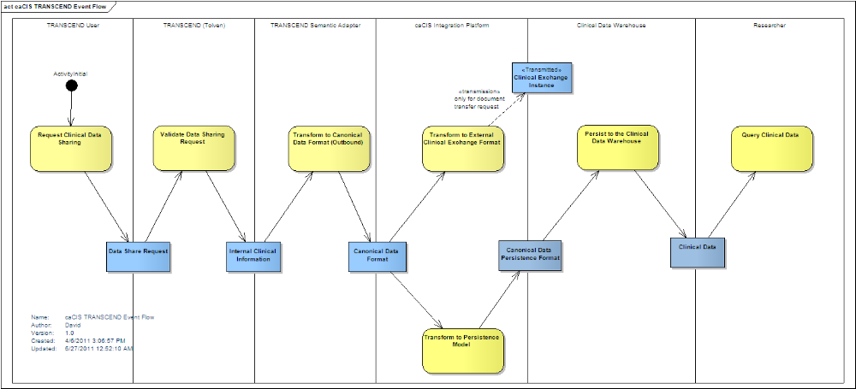
TRANSCEND – caCIS Integration – Event Flow
(Optimally Viewed in the Slide Show mode)

Slide 5
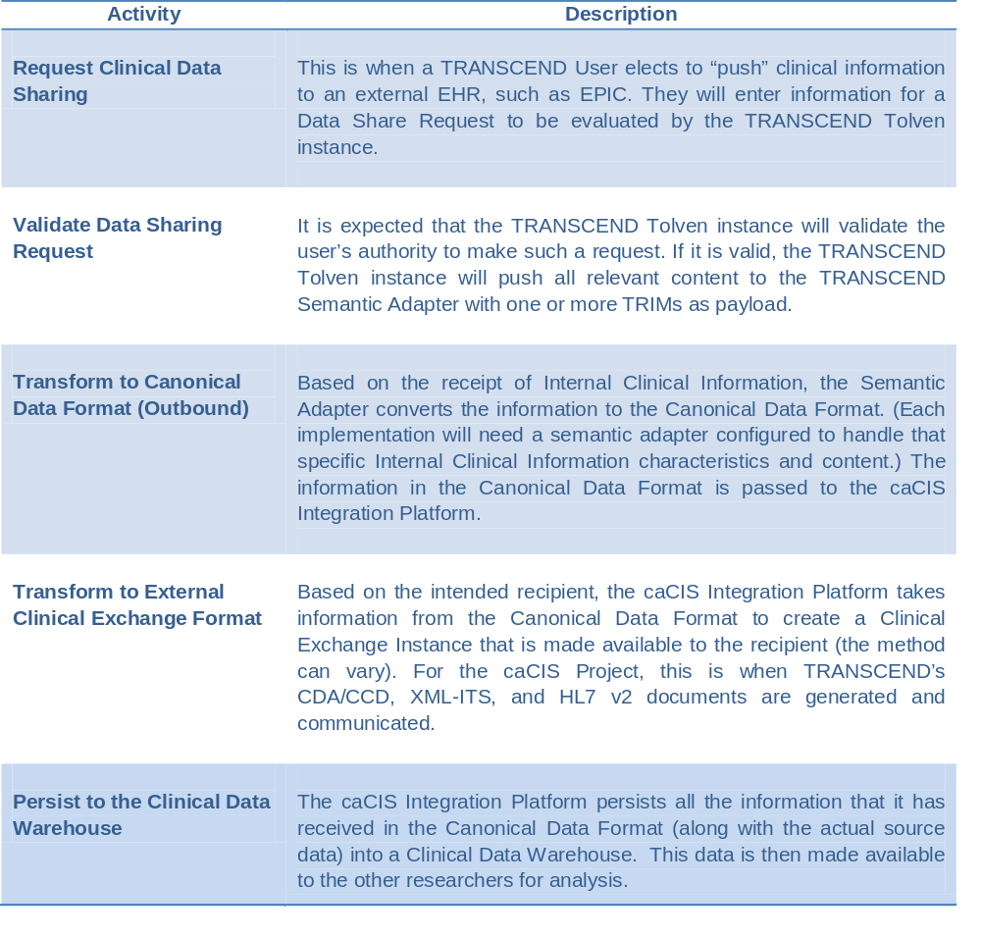
TRANSCEND – caCIS Integration – Event Flow

Slide 6
Proposed Integration Solution
Source System
(Tolven)
Secure Email
/ Secure FTP
Recipient/
Target System
Native
Format
(TRIM)
Integration Platform
Doc.
Transfer?
Semantic Adapter
Canonical
Model
Processor
Document
Router
NAV
Canonical
Model
Canonical
Model
Document
(Canonical
Model)
Extract
Transform
Load
OpenXDS
XDS
GET
Target
System
Clinical
Data
Clinical Data
Warehouse
Secured
Query
Interface
Clinical
Data

Slide 7
caCIS – Architectural Components - Definitions
No. | Term/Component | Definition
1. | Canonical format | Standards-based target data format that is used as a basis for creation of exchange instances and is also used to populate the Clinical Data Warehouse.
2. | Integration Platform (IP) | The overall caCIS infrastructure component that manages the verification of canonical information, generation and routing of exchange instances and management of transmission of data to the Clinical Data Warehouse. This is the component exposed to external systems involved in data exchange.
3. | Semantic Adapter (SA) | The component that transforms Internal Clinical Data into the Canonical format.
4. | OpenXDS | OpenXDS implements the Cross-Document Sharing (XDS) Registry and Repository. It is used for delivery of data to recipient systems.
5. | Document Router | The caCIS integration platform component responsible for managing the creation of exchange instances and delivering them to their intended recipients.
6. | Canonical Model Processor | The caCIS infrastructure component responsible for receiving information from various source systems (via their individual Semantic Adapter), validating the input data, transforming it into the warehouse persistence format and passing it to the clinical data warehouse.
7. | Clinical Data Warehouse | The repository where the Integration Platform persists clinical data for ad hoc querying.

Slide 8
caCIS – Architectural Components - Implementation Details
No. | Term/Component | Implementation Details
1. | Canonical format | Based on CCD and other broadly used CDA R2 templates
2. | Integration Platform (IP) | Mirth Connect (ESB)
3. | Semantic Adapter (SA) | Implementers can choose a platform that is acceptable to their enterprise. The caCIS integration platform is loosely coupled with the semantic adapter and this provides the flexibility to choose any implementation platform for SA.
4. | OpenXDS | OpenExchange provided by MOSS (Misys Open Source Solutions)
5. | Document Router | Deployed as component of the Integration Platform (on Mirth Connect)
6. | Canonical Model Processor | Deployed as a component of the Integration Platform (on Mirth Connect)
7. | Clinical Data Warehouse | Virtuoso - RDF/Triple store

Slide 9
caCIS – Architectural Components – Data Formats
Semantic Adapter
Integration Platform
Document Recipients
Data Warehouse
caCIS Request
caCIS Request
CDA/CCD
RDF Graphs
Routing Instructions
(Optional)
Routing Instructions
(Optional)
OR
Meta Data
(Optional)
Meta Data
HL7v2 Document
:
:
:
OR
Source Data
(Any format)
Canonical Model Data and
Untransformed Source Data
RIM ITS

Slide 10
caCIS – Information Model
It is expected that the caCIS Integration Platform be able to support multiple Clinical Applications as the source systems (the first implementation will use TRANSCEND Tolven as the source system).
caCIS Integration Platform transforms all clinical data it receives for document exchange into its “Canonical Information Model”.
A canonical information model is a model of the semantics and structure of information that adheres to a set of rules agreed upon within a defined context for communicating among a set of applications or parties.
caCIS canonical information model is HL7 CDA R2 (Clinical Document Architecture). If any of the clinical data for document exchange does not fit the CDA model, RIM extensions will be used.
CDA R2 is based on HL7 RIM v2.07 and HL7 Data Types R1.

Slide 11
caCIS – Information Model
HL7 CDA R2 as the Canonical Information Model
- Focus is on the clinical data
- Need to interoperate with a variety of clinical systems (e.g. EHRs)
- Many systems are capable of understanding and working with CDA documents
Use of CDA R2/CCD is expected to go up significantly due to the Meaningful Use
mandate for EHR systems under HITECH act

Slide 12
caCIS – Information Model
Wire Serialization Protocol and Schema
  Formats: CDA (CCD), RIM ITS, HL7 v2
  RDF used for persistence in CDW
  CDA is largely CCD compliant. If needed, RIM-based extensions.
  - RIM ITS and RDF will be direct representations of the CDA model
  - HL7v2 (specific message hasn't been chosen yet)
Value set bindings for coded concepts
  SNOMED-CT
  The approach is to use CCD-defined value sets or other industry standard value sets, where possible
Percentage of the schema directly bound to BRIDG/RIM/other?
All semantics are bound to the RIM
Semantics of "relationships between observations or actions”
Captured using the ActRelationship.typeCode attribute

Slide 13
caCIS – Information Model
Complex Data Types
  HL7 data type R1. No constraints beyond those enforced by CCD and related templates.

